Slide 1

Understanding and Working with Unaccompanied Children in Michigan

Slide 2
Introductions

Slide 3

Ana Raquel Devereaux Molly Huffaker
Managing Attorney Attorney Staff Attorney
Adevereaux@michiganimmigrant.org Mhuffaker@michiganimmigrant.org
Unaccompanied Children’s Team
Michigan Immigrant Rights Center
Intake line: 734-239-6863

Slide 4
The Michigan Immigrant Rights Center (MIRC) is a legal resource center for Michigan's immigrant communities. MIRC works to build a thriving Michigan where immigrant communities experience equity and belonging.
www.MichiganImmigrant.org
Facebook: www.facebook.com/MichiganImmigrant
Twitter: @MIRCadvocates

Slide 5

What MIRC Does
Builds capacity through education and training about immigration law and the complex relationship between immigration status and immigrants' rights in areas including access to public benefits, family law and child welfare, civil rights, and worker's rights.
•Answers questions and provides technical support to attorneys and advocates serving low-income immigrants.
•Recruits, trains, and mentors volunteer pro bono attorneys.
•Leads systemic advocacy to advance the rights of low-income immigrants and their families.
•Tracks and analyzes legislative and legal developments related to immigration law and immigrants' rights.
•Builds coalitions among immigrant advocacy and other social justice and civil rights organizations statewide.
•Represents individual clients in priority areas including naturalization and citizenship matters and the rights of survivors of domestic violence, refugees, unaccompanied minors, and farmworker rights.
•Represents clients in impact cases involving violations of civil rights by law enforcement or government entities, access to public benefits for immigrants and children of immigrants, the unauthorized practice of immigration law, and any other civil legal issue relating to immigration status.

Slide 6

Roadmap
Who is a UC?
  Legal definition
  Where do they come from and why?
What do UCs experience in the U.S.?
  Custodial systems
  Legal framework
Working with UCs
  How might you encounter them?
  What you can do to help?
  Case examples
Questions and Answer

Slide 7
Who is an UNACOMPANIED CHILD or UC?

Slide 8
Legal Definition
“Unaccompanied Alien Child” 6 USC 279(g)(2)
  No lawful immigration status
  Under 18 years old
  No parent or guardian in the U.S., or no parent/guardian who is “available to provide care and physical custody”

Slide 9

A Piece of the Puzzle
UC

Slide 10
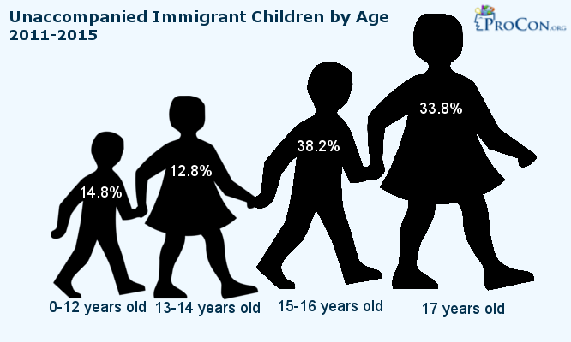

Slide 11
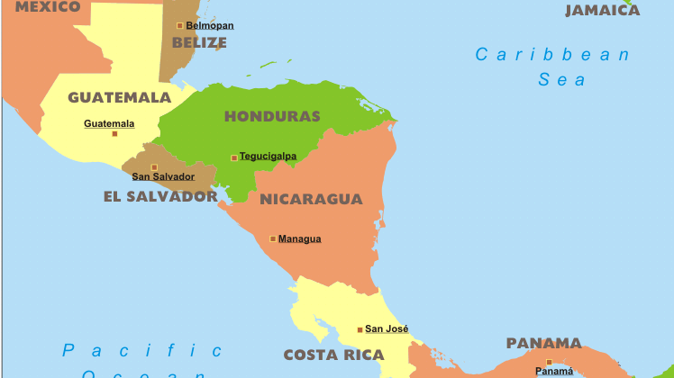
Where do UCs come from?
A UC can come from any country
The vast majority of UCs come from the Northern Triangle in Central America
  El Salvador
  Honduras
  Guatemala
Children from contiguous countries (e.g., Mexico) are subject to different procedures and more easily returned to their home countries

Slide 12
Why do they come?
  Family Reunification
  Violence – domestic and gang-based
  Persecution- Political or Identity-based
  Economic/Educational Opportunities

Slide 13
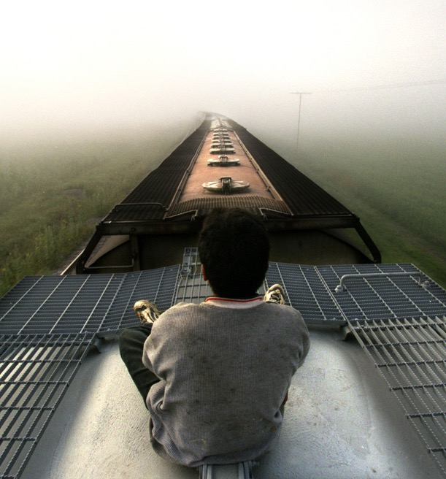
The Journey to the U.S.
  Many are injured/maimed trying to hitch rides on trains across Mexico
  Trek through the desert with little food/water
  UCs are often targets of trafficking and violence, by fellow travelers, coyotes, law enforcement, and gangs
  Border care concerns

Slide 14
What do UCs experience in the U.S.?

Slide 15
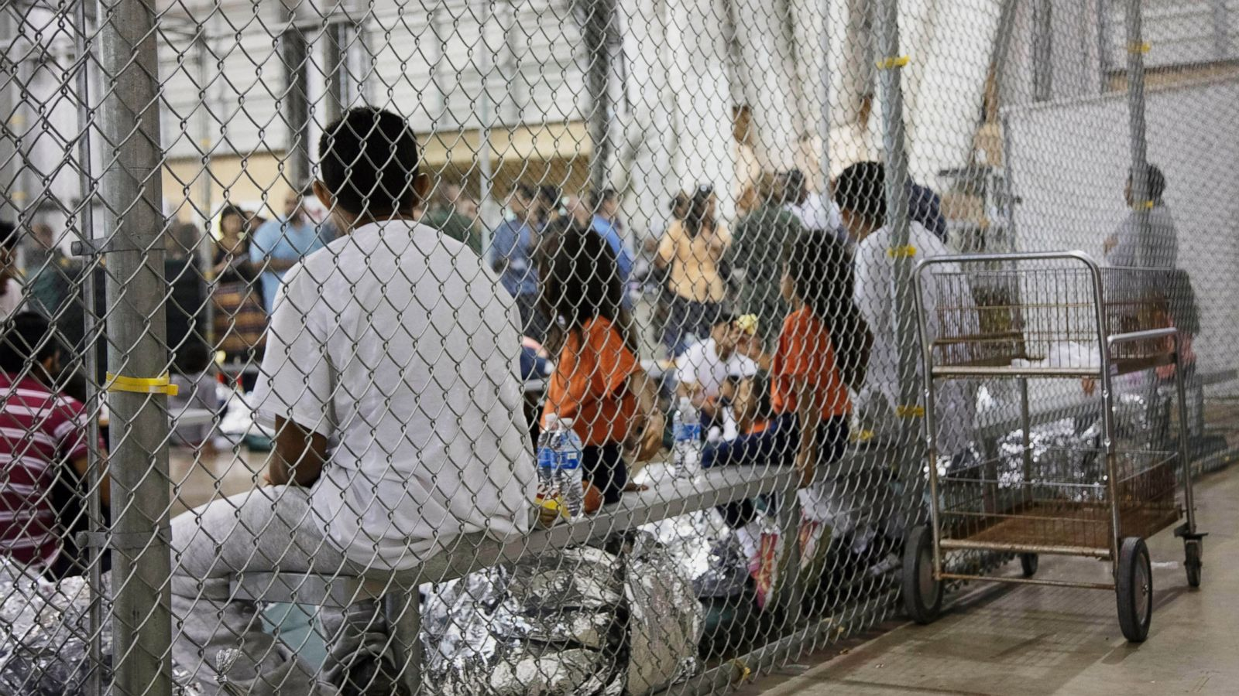
Border Facility Detention (CBP/ICE)

Slide 16
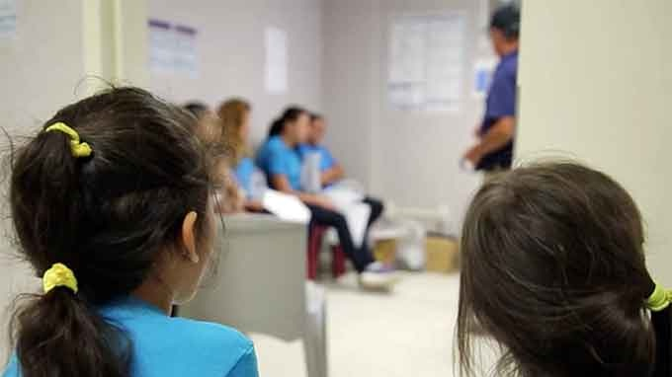
Office of Refugee Resettlement Custody
Short term care
  Initial medical and psychological screenings
  KYR/ Legal Screening
  Sponsor Screening
Long term care
  Until age 18
  Levels of Restriction in Care
    Long term foster care (MI)
    Staff Secure
    Secure
    Residential Treatment Center
  In MI, most transition to Unaccompanied Refugee Program (URM)

Slide 17
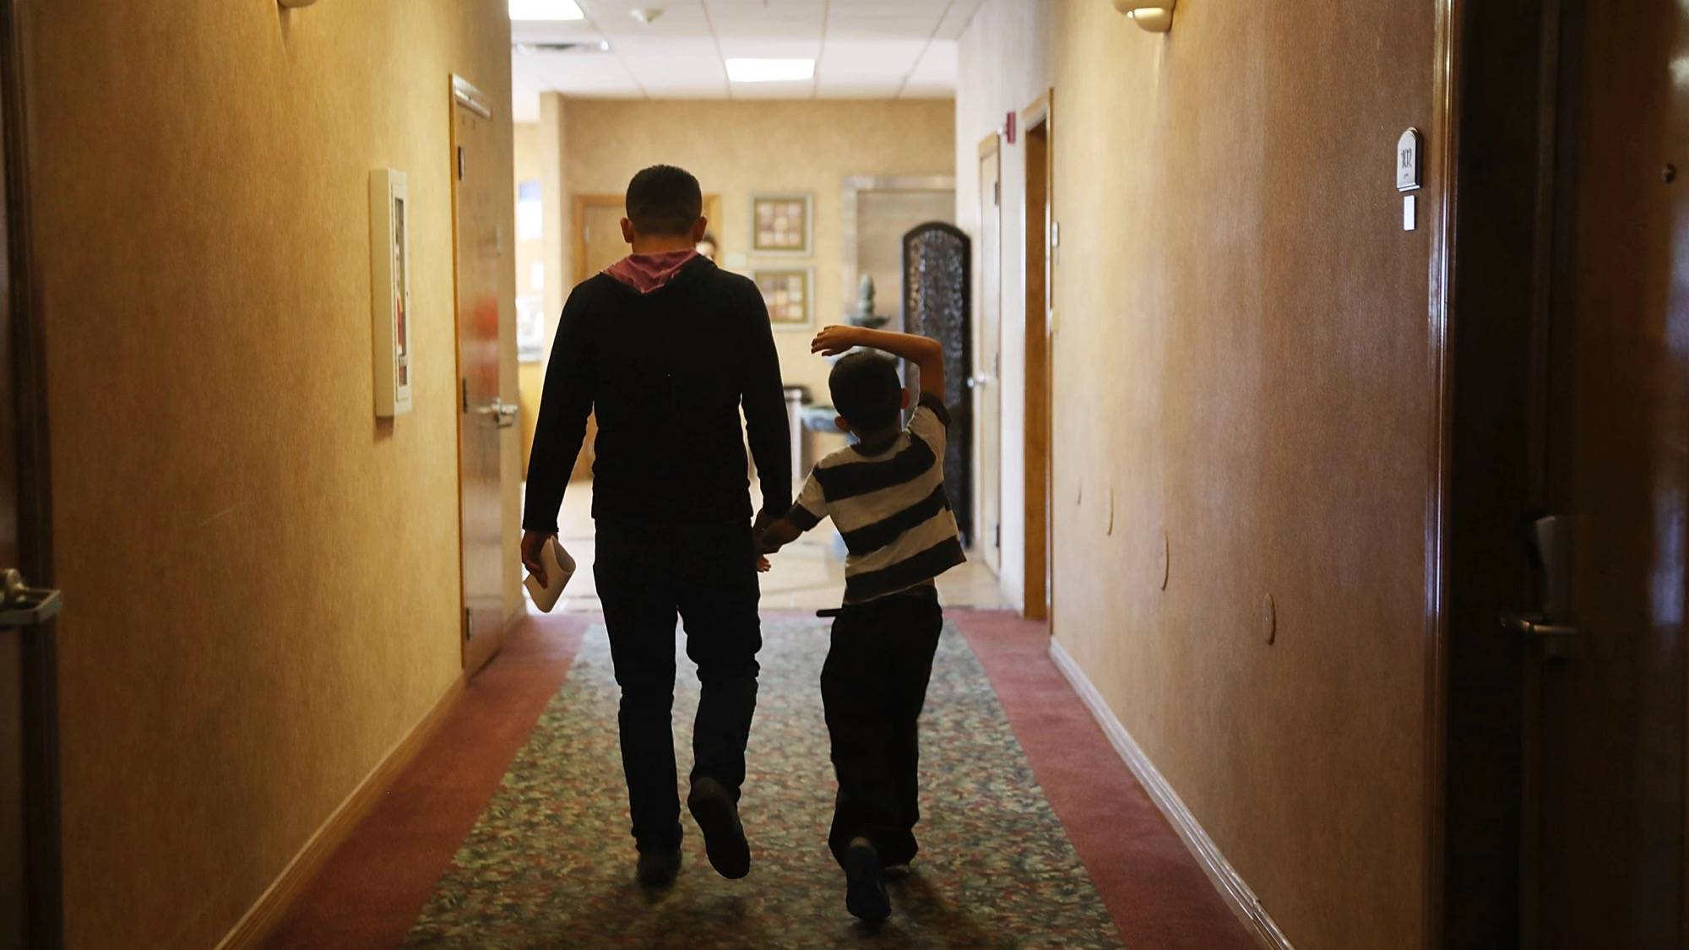
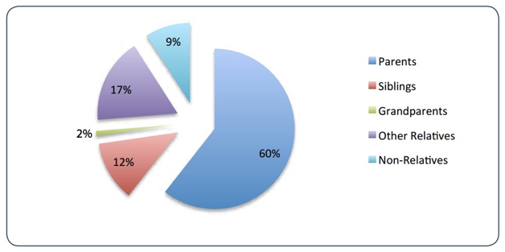
Release to Sponsors

Slide 18
Custodial Systems
Child leaves home country
Apprehension at Border
DHS Detention Facility
UAC Status
Determination
Transfer to ORR Custody
Placement with sponsor
Removal Proceedings
Relief
Removal

Slide 19
MIRC’S Role
KYR and Legal Screening presentation before release to sponsor
Representation if helpful during short-term
Representation for all children in long-term foster care
Some representation for Ucs released to sponsors in Michigan

Slide 20

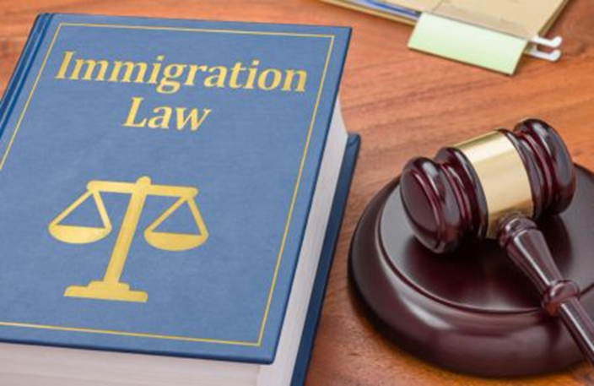
Legal Process

Slide 21
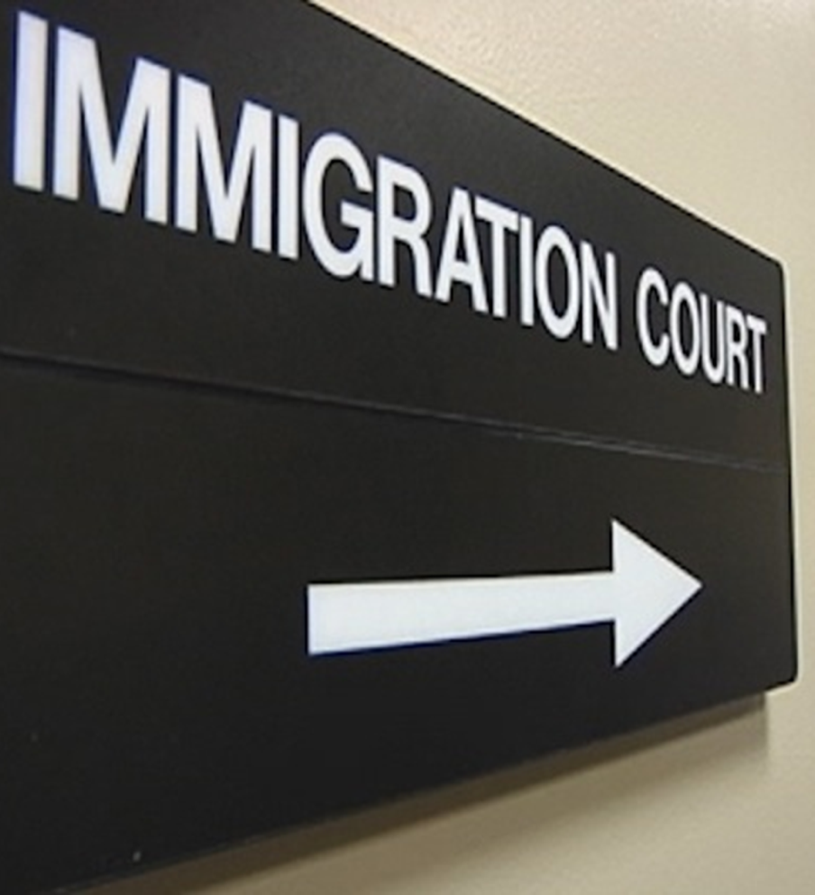
UC Legal Process
Arrival
Custody
Notice to Appear
Removal Proceedings
Defenses to removal
Relief or Deportation
Steps Beyond Relief in court- permanent residency and citizenship
(Outside of this process) can apply directly for these options without being in court or might

Slide 22
A Note on The System
Anti-Black and anti-Indigenous racism are foundational to anti-immigrant racism in the United States. The strategies and tactics of white supremacy carried out in chattel slavery and genocide inform every racist immigration policy that followed.
The immigration system is being effectively weaponized right now because it was designed to protect and promote white dominance.
The system is not “broken” – it was intended to work this way.
Because of the deep racist history of our immigration policy and the racist goals of policy makers, immigration status functions as a racial caste system in America.
Even though they are facially race-neutral, all systems that make distinctions based on citizenship or immigration status are furthering the system’s goal of perpetuating white dominance.
This is the system UCs enter and that defines their experience and creates one additional layer of trauma and barriers.

Slide 23
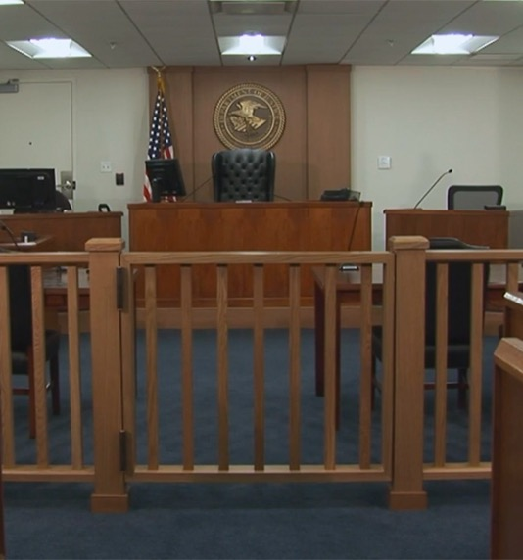
Immigration Court
Immigration Court is located in Detroit
Court oversees removal process
This process is independent from the process involved with getting reunified with a sponsor or from any other applications the attorney may file.

Slide 24
Common
Defenses to Removal for UCs
Special Immigrant Juvenile Status
Asylum
T Non Immigrant Status (“T Visa”)
U Non Immigrant Status (“U Visa”)

Slide 25
Special Immigrant Juvenile Status
Requires an action to be filed in state court
State court judge must make the following findings (INA 101(a)(27)(J)):
  Dependent on juvenile court
  Reunification with one or both parents is not viable due to abuse, neglect, abandonment, or a similar basis under State law;
  It would not be in the child’s best interest to be returned to the country of origin
  BCS handles this portion of the child’s case

Slide 26
SIJS and State Court Proceedings
Types of Proceedings
  Custody
  Guardianship
  Paternity
  Delinquency
  Abuse and Neglect
As a form of relief, the likelihood of SIJS being successful can vary wildly from state-to-state, or even county-to-county

Slide 27
SIJS Application
Completed by attorney
Submitted with orders from state court and other evidence
Processing time ranges from 13-18 months
Sometimes possible to expedite to avoid aging out

Slide 28
After SIJS Approval
NOT A STATUS
  Creates eligibility for a green card.
Visa Bulletin
  When a child can apply for a green card is determined by the Department of State’s Visa Bulletin
  Based on application’s Priority Date

Slide 29
Asylum
Definition of an asylee, INA 208(a)(1):
  A person:
    Physically present in the U.S. who arrives in the U.S.
    well-founded fear
    of persecution
    on account of race, religion, nationality, political opinion, or membership in a particular social group
    no state protection
Safe Third Country Agreements

Slide 30
Special Protections for UCs in Asylum Proceedings
Affirmative vs. Defensive Asylum Applications
  UCs who are in removal proceedings may first file an asylum application with USCIS
  This means the child will have an interview with an asylum officer in Chicago before going through Immigration Court
One-year bar
  UCs are not subject to the one-year bar on asylum applications
Even with these protections, winning asylum can be an uphill battle for many UCs
Losing at the asylum office results in a referral to Immigration Court- a second try

Slide 31
T Visas and Trafficking Letters
Trafficking Eligibility Letter
  Conferred by Office of Trafficking in Persons
  Not immigration status
  Grants eligibility to URM program
  States that child was victim of trafficking
T Visa
  Conferred by USCIS as immigration status
  For victims of “severe form of trafficking” who are present on account of said trafficking
  Having an eligibility letter does NOT make a child eligible for a T visa

Slide 32
U Visa
For victims of certain crimes in the United States
Requires that the child be reasonably helpful to law enforcement and a law enforcement certification
Most commonly seen
  Felonious assault
  Domestic violence
  Abusive sexual contact

Slide 33
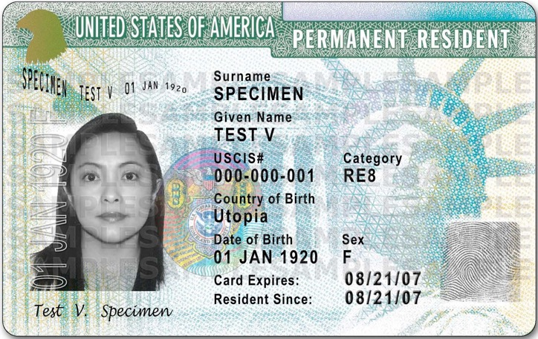
Green Card
When can the child file? It depends…
  Asylum: 1 year after approval
  SIJS: current priority date
  U and T visa: 3 years after approval
    T Visa only: after prosecution has ended
What does the process look like?
  Application for green card and work permit, and fee waiver request
  Biometrics
  Interview
  Medical Exam
  Possible second interview
  Grant or denial

Slide 34
Green Card
What does having a green card mean?
  The child is now a lawful permanent resident. It is more difficult for the government to deport them, but it is still possible.
  The child is automatically authorized to accept employment, and no longer has to renew their work authorization card.
  The child becomes an “eligible non-citizen,” and can apply for financial aid for college.

Slide 35
Citizenship
The only REAL deportation protection
Must hold green card a certain period of time
  Derive from adopted parents: 2 years, special timing rules
  Applying on own: must be age 18, hold for 5 years (unless marrying a USC, then it’s 3).

Slide 36
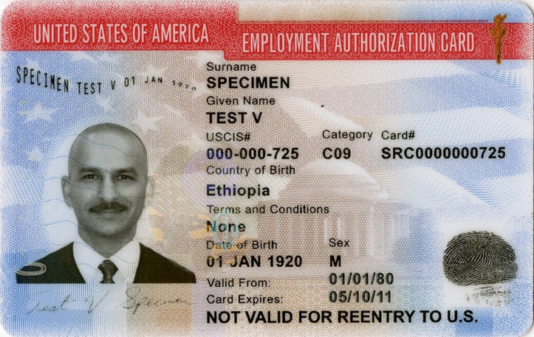
Employment Authorization
What is Employment Authorization?
  Employment authorization is permission to accept employment. It is given in two forms: stamped on an I-94 (arriving refugees), or an Employment Authorization Document (EAD).
When can my child apply?
  There must be an underlying reason, such as
    Pending asylum application (5 months)
    Approved asylum application
    Pending green card application
    NOTE: SIJS does NOT create eligibility for an EAD

Slide 37
Employment Authorization
Does the child get a Social Security number?
  Yes! The EAD application now contains a section to request a Social Security card.
Does the child get status?
  No. An EAD is NOT immigration status, rather, it is the product of status or pending status.
Can the child get a State ID with an EAD?
  Yes! The child needs their EAD, Social Security card, birth certificate, other form of ID, and 2 forms of address verification (school records count as one!). The SOS office does not always get this right, so you may have to ask for a manager to submit for what’s known as “the exceptions process.” Your caseworker can assist with this.

Slide 38
Working with
Unaccompanied Children

Slide 39
How might you encounter them?
In schools
In medical settings
In community settings
Victims of crime
Witnesses to crime

Slide 40
What you can do to help?
  Operate from a trauma-informed, culturally humble, anti-racist perspective
  Identify unmet needs (some which you can help meet, others you can advocate for broader change)
    Immigration services
    Social services
    Lack of ID, access to benefits
  Play your role in their journey well
    Can you provide a U-visa certification?
    Can you connect them to legal services to provide the legal relief based on what you’ve identified?
    Can you provide services (especially if the UC lacks public benefits to access otherwise)?
    Can you participate in advocacy to change systems that harm UCs or hinder their access to essential services?
  Acknowledge UC’s resilience and agency

Slide 41
Case Example #1
Maria traveled to the United States from her home in Central America in search of opportunity. She crossed the border undetected and went to live with a family member and worked. While in the community she met someone, entered a relationship, and became pregnant. Maria is fifteen when she arrives at a medical facility for prenatal treatment. Due to being a mandated reporter, her medical provider contacted CPS.
What might be some of this UC’s unmet needs at this time?
What might some next steps be for anyone of you encountering this youth?
What immigration relief are they likely eligible for?

Slide 42
Case Example #2
Mohammed fled his country in west Africa due to persecution based on his identity. He traveled through south and central America until coming to the U.S./Mexico border. Once at the border, he was designated an unaccompanied child and placed in ORR custody. While in ORR custody, he was abused. When he disclosed this abuse to his caseworker, the caseworker filed a report with CPS and helped Mohammed file a police report.
What might be some of this UC’s unmet needs at this time?
What might some next steps be for anyone of you encountering this youth?
What immigration relief are they likely eligible for?

Slide 43
Case Example #3
Gabriel came to the United States from the Caribbean by way of the U.S./Mexico border. After a short time in ORR care, they were released to a sponsor. However, after living with their family member, they are forced to work in the family owned business, along with other trafficked individuals. Law enforcement eventually identify the place of employment as a source of trafficking and conduct a workplace raid in which Gabriel is identified as being a victim and being underage.
What might be some of this UC’s unmet needs at this time?
What might some next steps be for anyone of you encountering this youth?
What immigration relief are they likely eligible for?

Slide 44

Questions?

